Slide 1
UML Statechart Diagram
A state diagram describes the behaviour of a system, some part of a system, or an individual object.
At any given point in time, the system or object is in a certain state.
Being in a state means that it is will behave in a specific way in response to any events that occur.
Some events will cause the system to change state.
In the new state, the system will behave in a different way to events.
A state diagram is a directed graph where the nodes are states and the arcs are transitions.

Slide 2
UML Statechart Diagram
Statechart diagram is one of the five UML diagrams used to model dynamic nature of a system.
They define different states of an object during its lifetime. And these states are changed by events.
So Statechart diagrams are useful to model reactive systems. Reactive systems can be defined as a system that responds to external or internal events.
Statechart diagram describes the flow of control from one state to another state.
States are defined as a condition in which an object exists and it changes when some event is triggered.
So the most important purpose of Statechart diagram is to model life time of an object from creation to termination.

Slide 3
States
At any given point in time, the system is in one state.
It will remain in this state until an event occurs that causes it to change state.
A state is represented by a rounded rectangle containing the name of the state.
Special states:
A black circle represents the start state
A circle with a ring around it represents an end state

Slide 4
Transitions
A transition represents a change of state in response to an event.
It is considered to occur instantaneously.
The label on each transition is the event that causes the change of state.

Slide 5
State diagrams – an example of transitions with time-outs and conditions
GreenLight
after(25s)
YellowLight
after(30s)
after(5s)
RedLight

Slide 6
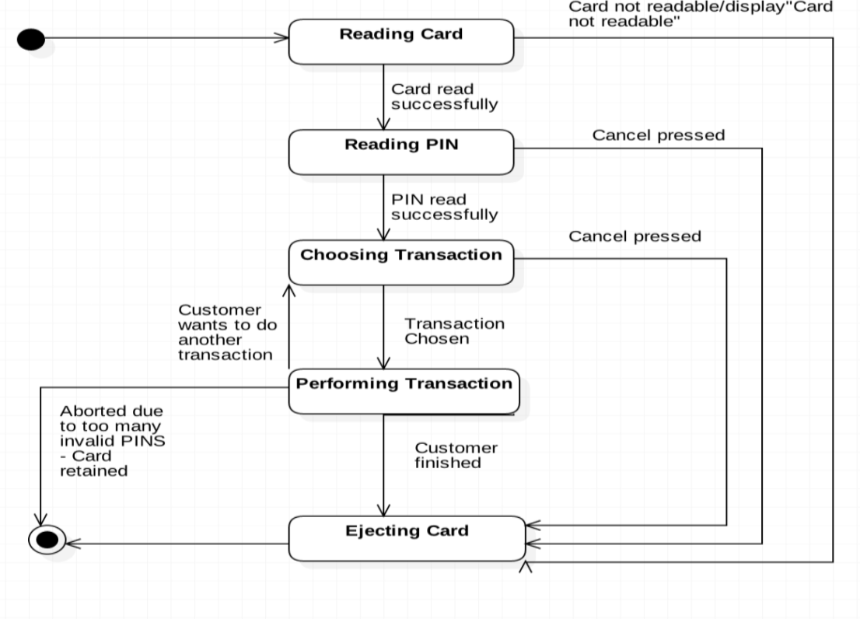
State Chart of ATM Withdraw

Slide 7
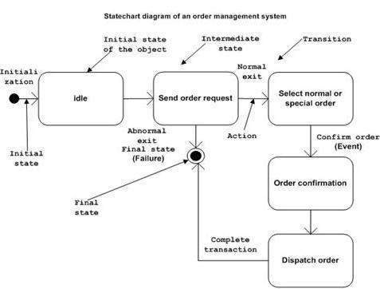

Slide 8
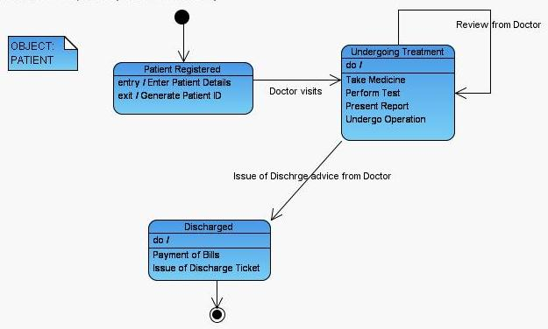
State Chart Diagram for Patient

Slide 9
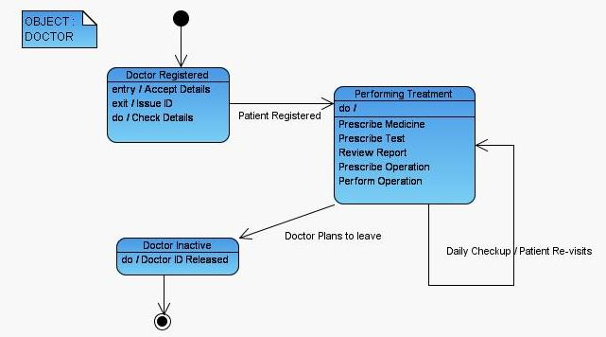
State Diagram for Doctor

Slide 10
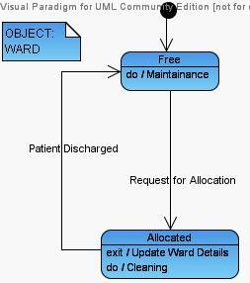
State Diagram for Ward Object

Slide 11
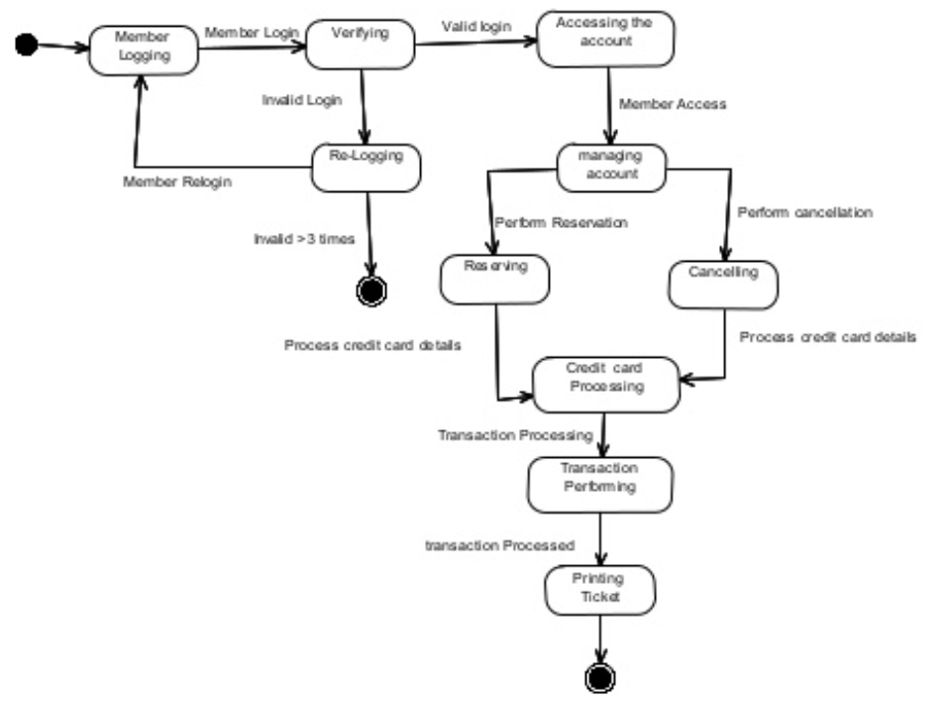

Slide 12
Practical implementation of State chart diagram
To model the object states of a system.
To model the reactive system. Reactive system consists of reactive objects.
To identify the events responsible for state changes.
Forward and reverse engineering.

Slide 13
UML Activity Diagram
An activity diagram visually presents a series of actions or flow of control in a system similar to a flowchart or a data flow diagram.
Activity diagrams are often used in business process modeling.
They can also describe the steps in a use case diagram. Activities modeled can be sequential and concurrent.
In both cases an activity diagram will have a beginning (an initial state) and an end (a final state).

Slide 14
UML Activity Diagram
Activity diagram is basically a flow chart to represent the flow form one activity to another activity. The activity can be described as an operation of the system.
It captures the dynamic behaviour of the system.
activity diagram is used to show message flow from one activity to another.

Slide 15
The purposes can be described as:
Draw the activity flow of a system.
Describe the sequence from one activity to another.
Describe the parallel, branched and concurrent flow of the system.

Slide 16

Basic Activity Diagram Notations and Symbols
Initial State or Start Point
A small filled circle followed by an arrow represents the initial action state or the start point for any activity diagram.
For activity diagram using swimlanes, make sure the start point is placed in the top left corner of the first column.

Slide 17
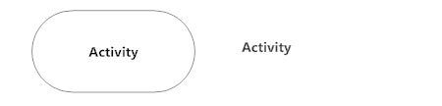
Basic Activity Diagram Notations and Symbols
Activity or Action State
An action state represents the non-interruptible action of objects.
action state can be represented using a rectangle with rounded corners.

Slide 18

Basic Activity Diagram Notations and Symbols
Action Flow
Action flows, also called edges and paths, illustrate the transitions from one action state to another. They are usually drawn with an arrowed line.

Slide 19
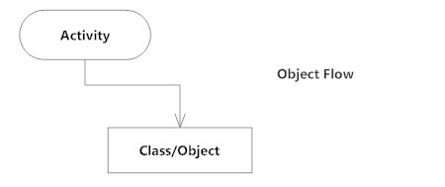
Basic Activity Diagram Notations and Symbols
Object Flow
Object flow refers to the creation and modification of objects by activities.
An object flow arrow from an action to an object means that the action creates or influences the object. An object flow arrow from an object to an action indicates that the action state uses the object.

Slide 20

Basic Activity Diagram Notations and Symbols
Decisions and Branching
A diamond represents a decision with alternate paths.
When an activity requires a decision prior to moving on to the next activity, add a diamond between the two activities. The outgoing alternates should be labeled with a condition or guard expression. You can also label one of the paths "else."

Slide 21
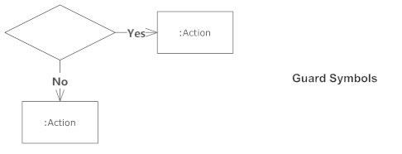
Basic Activity Diagram Notations and Symbols
Guards
In UML, guards are a statement written next to a decision diamond that must be true before moving next to the next activity. These are not essential, but are useful when a specific answer, such as "Yes, three labels are printed," is needed before moving forward.

Slide 22
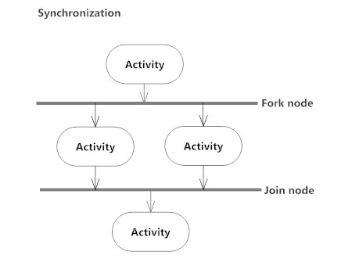
Basic Activity Diagram Notations and Symbols
Synchronization
A fork node is used to split a single incoming flow into multiple concurrent flows. It is represented as a straight, slightly thicker line in an activity diagram.
A join node joins multiple concurrent flows back into a single outgoing flow.
A fork and join mode used together are often referred to as synchronization.

Slide 23
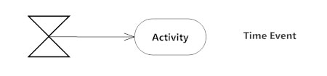
Basic Activity Diagram Notations and Symbols
Time Event
This refers to an event that stops the flow for a time; an hourglass depicts it.

Slide 24
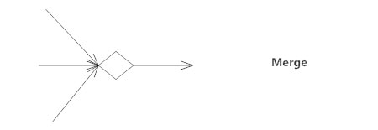
Basic Activity Diagram Notations and Symbols
Merge Event
A merge event brings together multiple flows that are not concurrent.

Slide 25
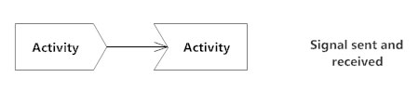
Basic Activity Diagram Notations and Symbols
Sent and Received Signals
Signals represent how activities can be modified from outside the system.
They usually appear in pairs of sent and received signals, because the state can't change until a response is received, much like synchronous messages in a sequence diagram.
For example, an authorization of payment is needed before an order can be completed.

Slide 26

Basic Activity Diagram Notations and Symbols
Final State or End Point
An arrow pointing to a filled circle nested inside another circle represents the final action state

Slide 27
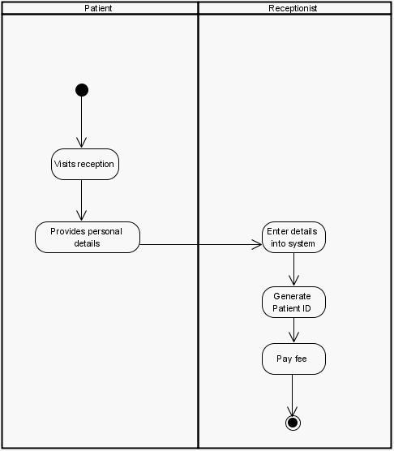
Activity Diagram Registration :-

Slide 28
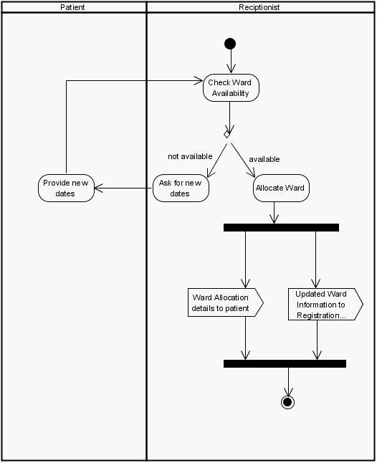
Activity Diagram for Ward Allocation:-

Slide 29
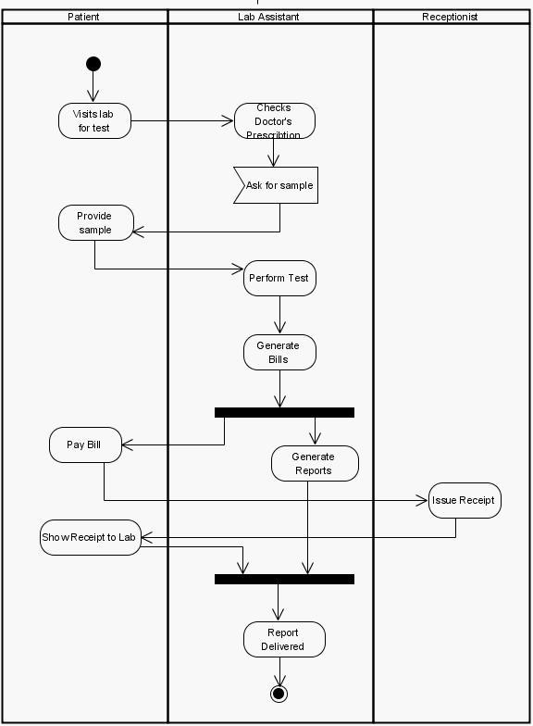
Activity Diagram for Tests to Perform:-

Slide 30
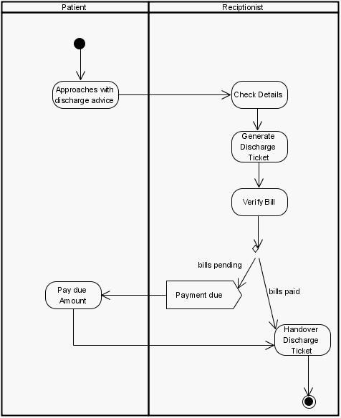
Activity Diagram Discharge:-

Slide 31
